Slide 1
Image segmentation techniques
Prepared by: Lim Jia Qi

Slide 2
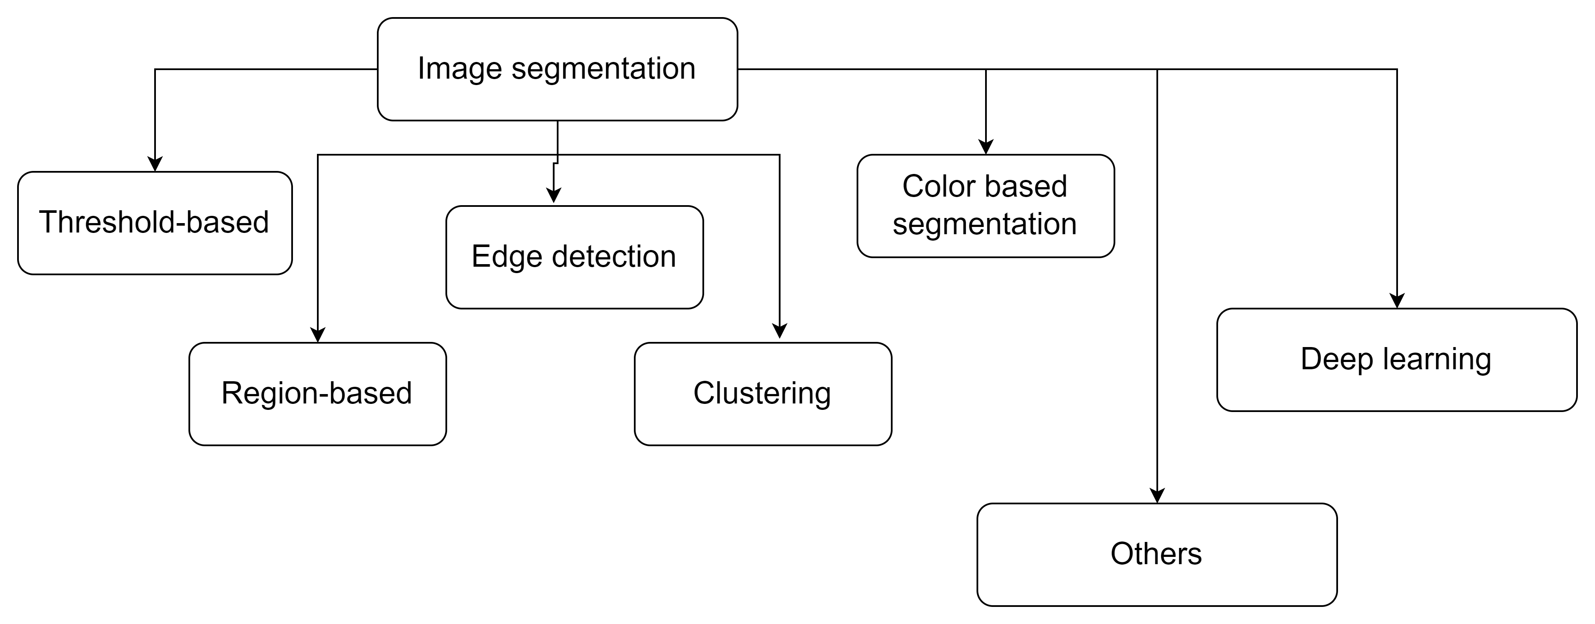
From week 8
K-means clustering

Slide 3
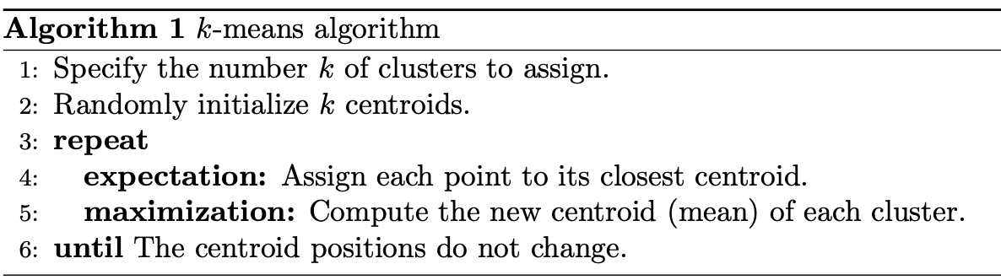
K-means clustering
Unsupervised ML technique used to identify clusters of data objects.

Slide 4
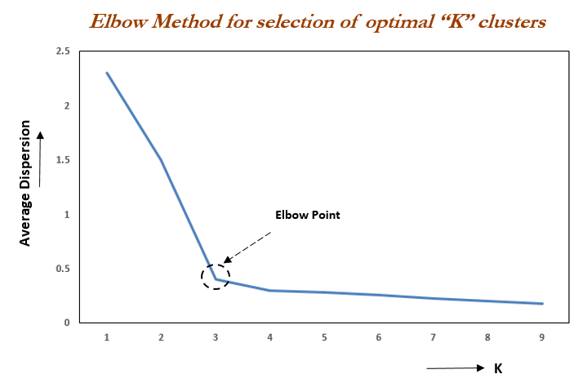

How to choose k?
The elbow method plots the value of the cost function produced by different values of k.
Image credit: https://www.oreilly.com/library/view/statistics-for-machine/9781788295758/c71ea970-0f3c-4973-8d3a-b09a7a6553c1.xhtml

Slide 5
Anisotropic segmentation

Slide 6


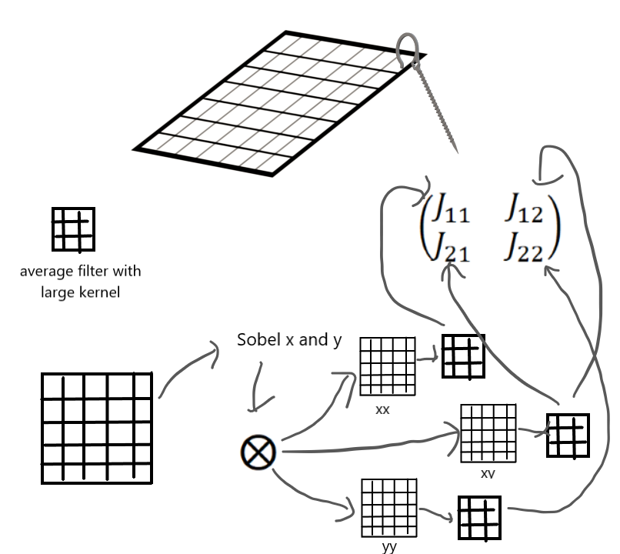




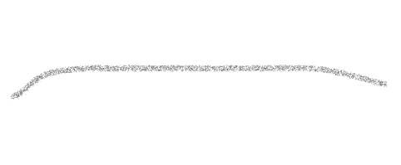
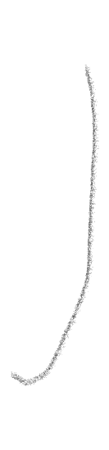




Anisotropic segmentation
Compute eigenvalues and eigenvectors
Apply formula to calculate orientation and coherency*
Apply thresholding on the coherency / orientation map.
* The formula can be found on OpenCV documentation.

Slide 7
From week 8
Watershed segmentation

Slide 8

Watershed segmentation
Assumption: grayscale image can be considered as topographic surface.
If we flood this surface from its minima, and if we prevent the merging of the waters, we will end up with 2 sets: catchment basins and the watershed lines.
However, this transform produces over-segmentation. A major enhancement of watershed is the predefined markers before flooding.
Segments an image into several catchment basins.

Slide 9
How to select the markers?
Distance transform.
Morphological operations
Thresholding

